Slide 1
Data Driven AI
Week 9 – Convolutional Neural Network (CNN) Models
Dr. Abirami Gunasekaran
CHS2406: Data-driven AI

Slide 2
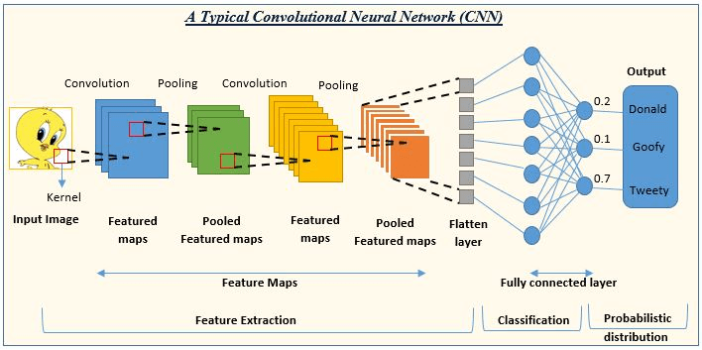
Introduction to CNN
Learns multi-level features and classification in a joint fashion and performs much better than traditional approaches for various image classification and segmentation problems.
Image source:Almabetter

Slide 3
Convolutional Neural Network-Components
Convolutional Layer
It acts as a feature extractor that extract features of the inputs such as edges, corners, endpoints. It can be one or more in the model.
Activation Function
It is used to introduce non-linearity in CNN, since most of the real-world problems are non-linear.
Pooling layer
It reduces the spatial dimensions of input data while keeping the most important information. It's also known as downsampling or subsampling.

Slide 4
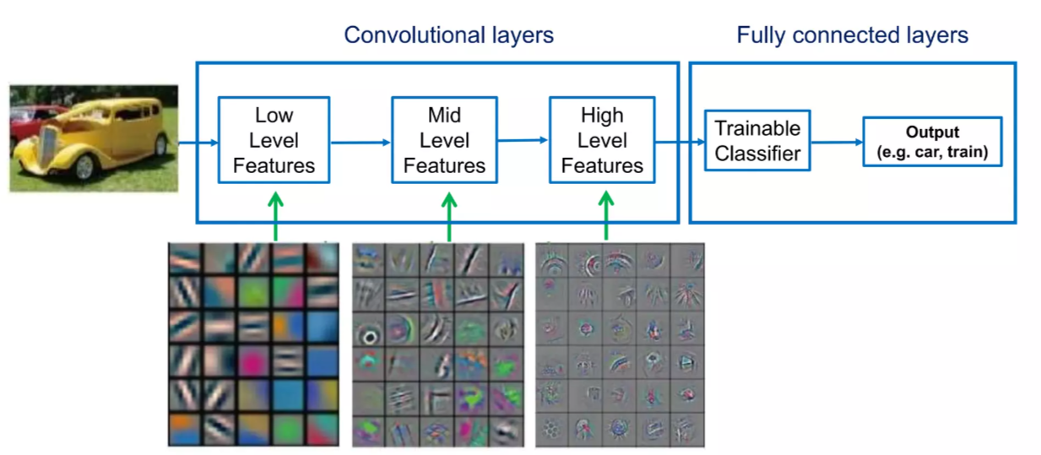
CNN – What do they Learn?

Slide 5
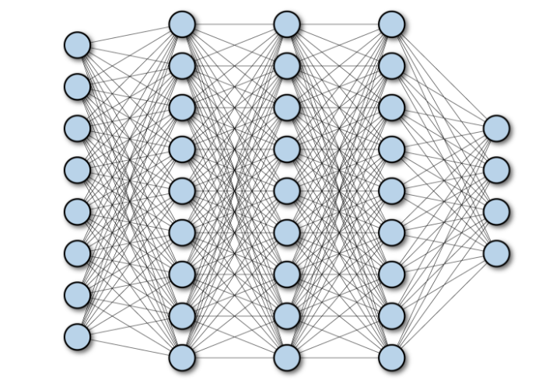
Fully Connected Neural Network
No. of Neurons in
Input Layer = 8
Hidden Layers = 9
Output Layer = 4
Total Parameters to Learn at,
Hidden Layer 1:
9 x 8 = 72
Hidden Layer 2 :
9 x 9 = 81
Hidden Layer 3 :
9 x 9 = 81
Output Layer :
9 x 4 = 36

Slide 6
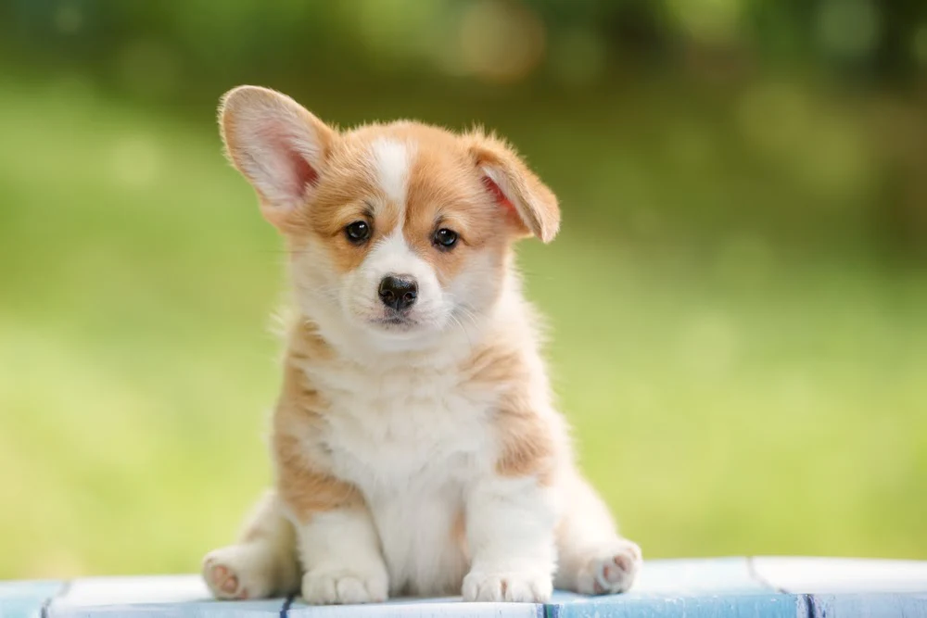
Input Image Dimension & NN Parameters
Input Image’s Dim = (800, 800,3)
No. of Inputs:
800 x 800 x 3 = 1,920,000
No. of H1 neurons : 10000
No. of parameters @H1:
1,920,000 x 10000 = 19,200,000,000
No. of H2 neurons : 10000
No. of parameters @H2:
10000 x 10000 = 100,000,000
H3,..etc.,

Slide 7
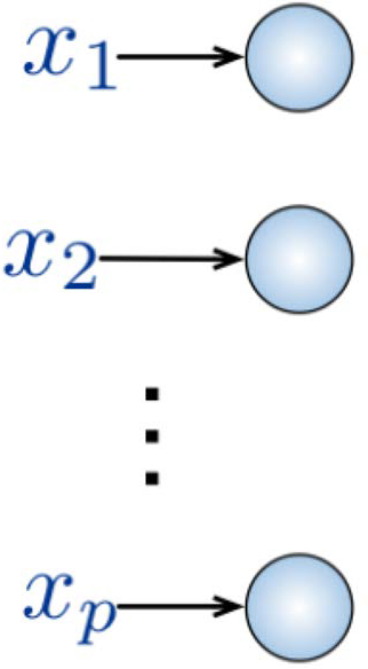

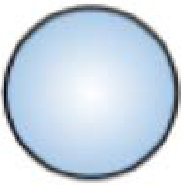


Fully Connected Neural Network
Input:
Fully Connected:
2D image
Vector of pixel values
Each neuron in hidden layer connected to all neurons in input layer
No spatial information
Many, many parameters
Key idea: Use spatial structure in input to inform architecture of the network

Slide 8
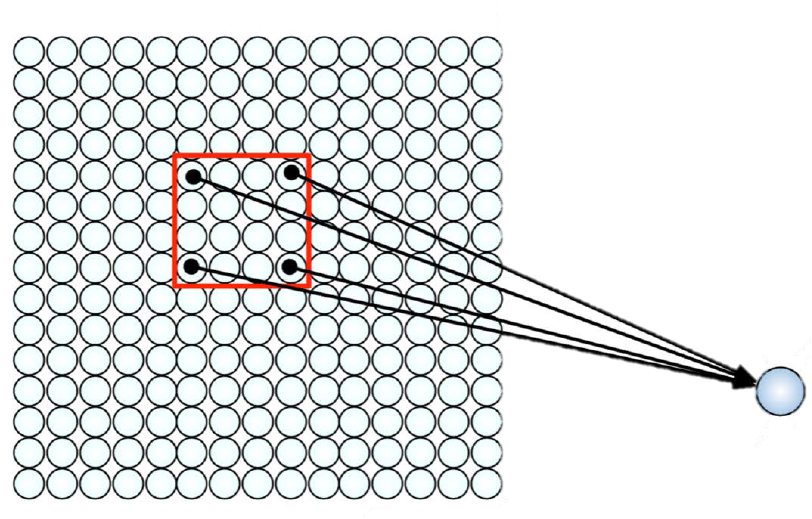
Using Spatial Structure
Input: 2D image.
Array of pixel values
Idea: connect patches of input to neurons in hidden layer.
Neuron connected to region of input. Only “sees”these values.

Slide 9
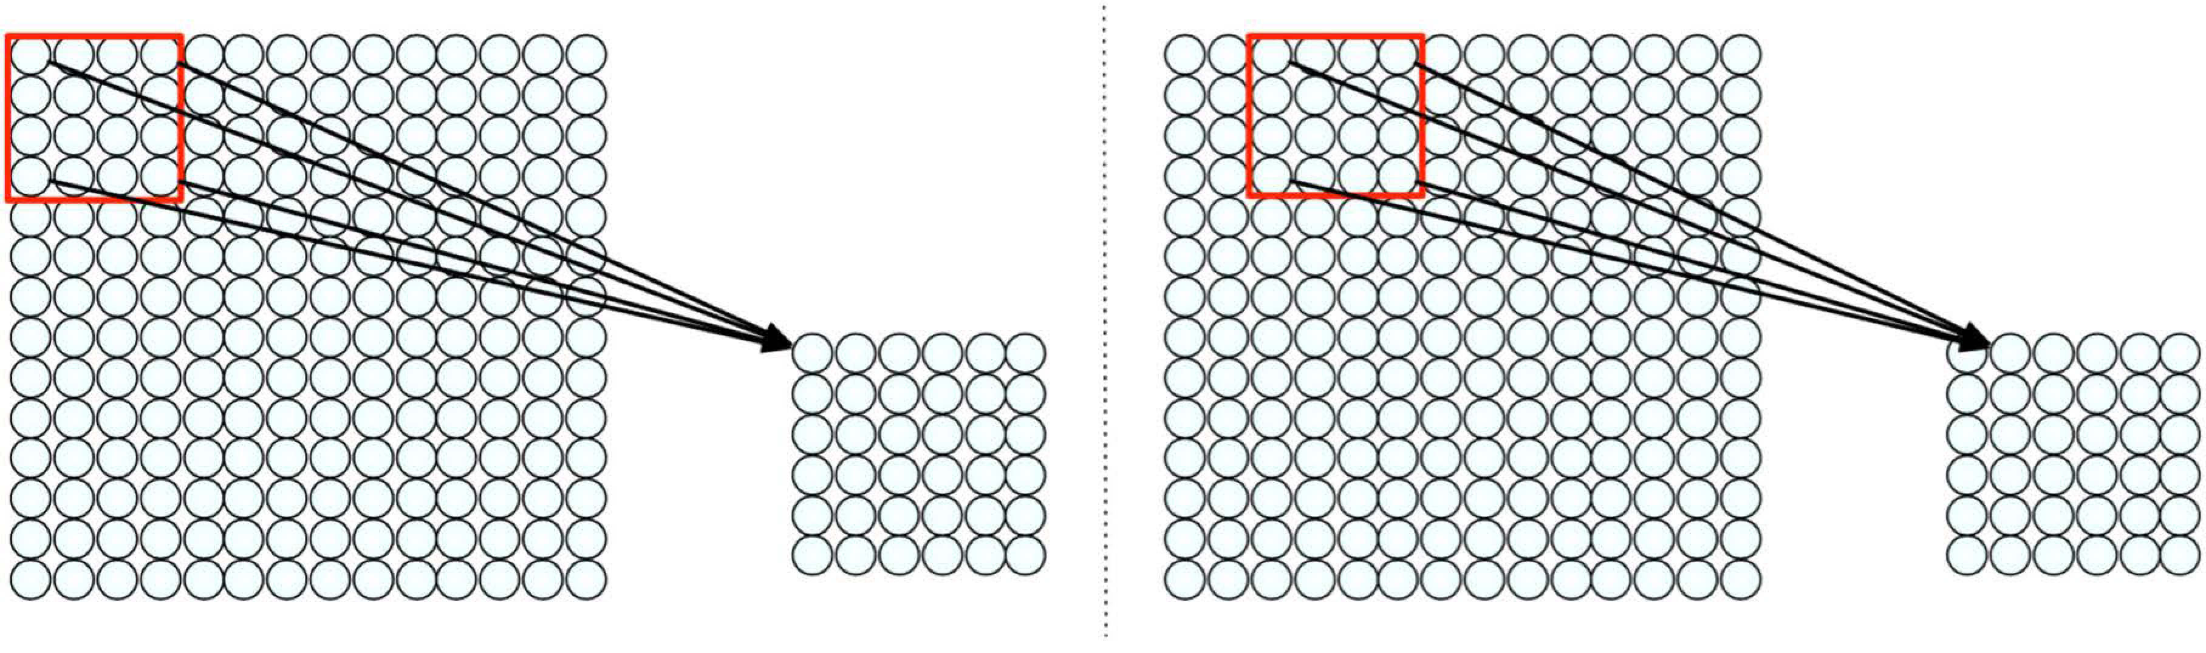
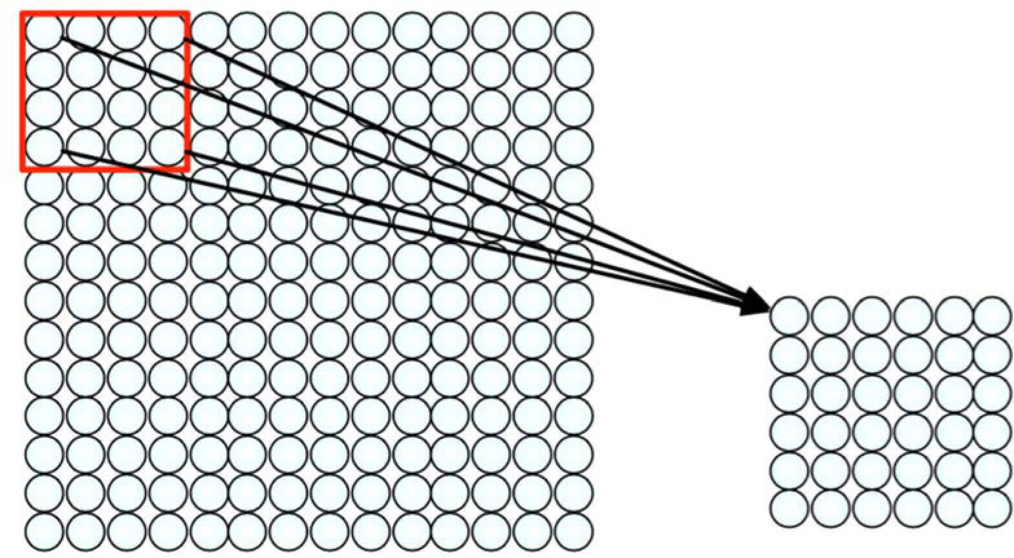
Using Spatial Structure
Connect patch in input layer to a single neuron in subsequent layer.
Use a sliding window to define connections.
How can we weight the patch to detect particular features?

Slide 10
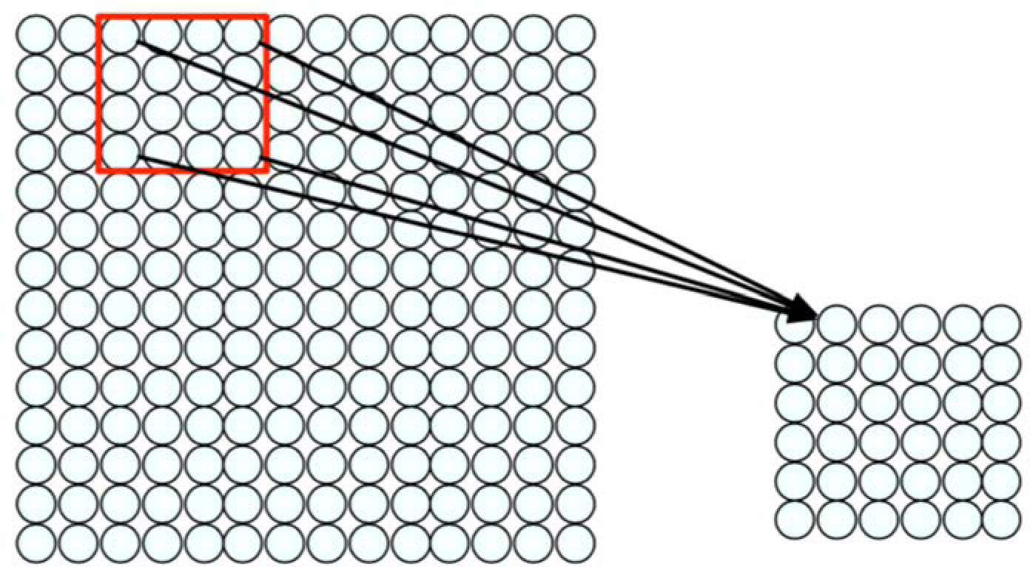
Feature Extraction with Convolution
Filter of size 4x4 : 16 different weights
Apply this same filter to 4x4 patches in input
Shift by 2 pixels for next patch
This “patchy” operation is convolution
Apply a set of weights – a filter – to extract local features
Use multiple filters to extract different features
Spatially share parameters of each filter

Slide 11
Convolution
Terminologies

Slide 12





Fully Connected Layer
32x32x3 image -> stretch to 3072 x 1
input
activation
1
1
10 x 3072
weights
3072
10
1 number:
the result of taking a dot product between a row of W and the input (a 3072-dimensional dot product)
Fei-Fei Li, Yunzhu Li, Ruohan Gao

Slide 13
Convolution Layer
32x32x3 image -> preserve spatial structure
32
height
32
depth
width
3
Fei-Fei Li, Yunzhu Li, Ruohan Gao

Slide 14
Convolution Layer
32x32x3 image
5x5x3 filter
32
Convolve the filter with the image
i.e. “slide over the image spatially, computing dot products”
3
32

Slide 15
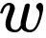
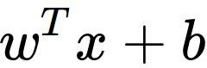
Convolution Layer
32x32x3 image 5x5x3 filter
32
1 number:
the result of taking a dot product between the filter and a small 5x5x3 chunk of the image
(i.e. 5*5*3 = 75-dimensional dot product + bias)
32
3
Fei-Fei Li, Yunzhu Li, Ruohan Gao

Slide 16
Convolution Layer
32
32
3
Fei-Fei Li, Yunzhu Li, Ruohan Gao

Slide 17
Convolution Layer
32
32
3
Fei-Fei Li, Yunzhu Li, Ruohan Gao

Slide 18
Convolution Layer
32
32
3
Fei-Fei Li, Yunzhu Li, Ruohan Gao

Slide 19
Convolution Layer
32
32
3
Fei-Fei Li, Yunzhu Li, Ruohan Gao

Slide 20
Convolution Layer
activation map
32x32x3 image 5x5x3 filter
32
28
convolve (slide) over all spatial locations
32
28
3
1
Fei-Fei Li, Yunzhu Li, Ruohan Gao

Slide 21


Convolution Layer
6 activation maps, each 1x28x28
3x32x32 image
Consider 6 filters, each 3x5x5
Convolution Layer
32
32
6x3x5x5
filters
Stack activations to get a
6x28x28 output image!
3
Fei-Fei Li, Yunzhu Li, Ruohan Gao
21

Slide 22

Convolution Layer
6 activation maps, each 1x28x28
3x32x32 image
Also 6-dim bias vector:
Convolution Layer
32
32
6x5x5
filters
Stack activations to get a
6x28x28 output image!
3
Fei-Fei Li, Yunzhu Li, Ruohan Gao
22

Slide 23
Convolution Layer
28x28 grid, at each point a 6-dim vector
3x32x32 image
Also 6-dim bias vector:
Convolution Layer
32
32
6x5x5
filters
Stack activations to get a
6x28x28 output image!
3
23

Slide 24

Convolution Layer
2x6x28x28 Batch of outputs
2x3x32x32
Batch of images
Also 6-dim bias vector:
Convolution Layer
32
32
6x5x5 filters
3
Fei-Fei Li, Yunzhu Li, Ruohan Gao
24

Slide 25
Convolution Layer
N x C x H’ x W’
out
N x C x H x W
Batch of outputs
in
Also C
-dim bias vector:
Batch of images
out
Convolution Layer
H
W
C_{out} x C_{in}x K_{w} x K_{h} filters
C
C
out
in
Fei-Fei Li, Yunzhu Li, Ruohan Gao
25

Slide 26
Feature Map Size
The size of the output volume is controlled by three parameters that we need to decide before the convolution step is performed:
Depth: Depth corresponds to the number of filters we use for the convolution operation.
Stride: Stride is the number of pixels by which we slide our filter matrix over the input matrix.
Zero-padding: Sometimes, it is convenient to pad the input matrix with zeros around the border, so that we can apply the filter to bordering elements of our input image matrix.
With zero-padding wide convolution
Without zero-padding narrow convolution

Slide 27
Stride
Basic convolution slides the filter on the image one pixel at a time
Stride = 1

Slide 28
Stride
Basic convolution slides the filter on the image one pixel at a time
Stride = 1
stride = 1

Slide 29
Stride
Basic convolution slides the filter on the image one pixel at a time
Stride = 1
stride = 1

Slide 30
Stride
Basic convolution slides the filter on the image one pixel at a time
Stride = 1
stride = 1

Slide 31
Stride
Basic convolution slides the filter on the image one pixel at a time
Stride = 1
Can define a different stride
Hyperparameter
stride = 2

Slide 32
Stride
Basic convolution slides the filter on the image one pixel at a time
Stride = 1
Can define a different stride
Hyperparameter
stride = 2

Slide 33
Stride
Basic convolution slides the filter on the image one pixel at a time
Stride = 1
Can define a different stride
Hyperparameter
stride = 2

Slide 34
Stride
Basic convolution slides the filter on the image one pixel at a time
Stride = 1
Can define a different stride
Hyperparameter
stride = 2

Slide 35
Stride
Basic convolution slides the filter on the image one pixel at a time
Stride = 1
Can define a different stride
Hyperparameter
stride = 2
Works in both directions!

Slide 36
Stride
Basic convolution slides the filter on the image one pixel at a time
Stride = 1
Can define a different stride
Hyperparameter
Stride reduces the number of multiplications
Subsamples the image
stride = 3

Slide 37
Stride
Basic convolution slides the filter on the image one pixel at a time
Stride = 1
Can define a different stride
Hyperparameter
Stride reduces the number of multiplications
Subsamples the image
stride = 3

Slide 38
Stride
Basic convolution slides the filter on the image one pixel at a time
Stride = 1
Can define a different stride
Hyperparameter
Stride reduces the number of multiplications
Subsamples the image
stride = 3

Slide 39
Activation Map Size
What is the size of the image after application of a filter with a
given size and stride?
W=7
General rule
𝑊′ = ^{𝑊 − 𝐾} + 1
H=7
𝑆
𝐻′ = ^{𝐻 − 𝐾} + 1
𝑆

Slide 40
Activation Map Size
What is the size of the image after application of a filter with a
given size and stride?
W=7
Take a 3x3 filter with stride 1
K=3, S=1
H=7
Output image is: 5x5

Slide 41
Activation Map Size
What is the size of the image after application of a filter with a
given size and stride?
W=7
Take a 3x3 filter with stride 2
K=3, S=2
H=7
Output image is: 3x3

Slide 42
Activation Map Size
What is the size of the image after application of a filter with a
given size and stride?
W=7
Take a 3x3 filter with stride 3
K=3, S=3
H=7
Output image is:
Doesn’t fit! Cannot scan the whole image

Slide 43
Zero Padding
Add columns and rows of zeros to the border of the
image
W=7
0 | 0 | 0 | 0 | 0 | 0 | 0 | 0 | 0
0
0
0
0
0
0
0
0
H=7

Slide 44
Zero Padding
Add columns and rows of zeros to the border of the
image
W=7 (P=1)
0 | 0 | 0 | 0 | 0 | 0 | 0 | 0 | 0
0
0
0
0
0
0
0
0
K=3, S=1
Output image is?
H=7
(P = 1)
_{𝑊′ =} 𝑊 − 𝐾 + 2𝑃 ₊ ₁
𝑆
Ans is :7x7

Slide 45
Zero Padding
Add columns and rows of zeros to the border of the
image
W=7 (P=1)
0 | 0 | 0 | 0 | 0 | 0 | 0 | 0 | 0
0
0
0
0
0
0
0
0
Zero padding serves to retain the original size of image
𝐾 − 1
H=7
(P = 1)
𝑃 =
2
Pad as necessary to perform convolutions with a given stride S

Slide 46
Examples time:
Input volume: 32x32x3
10 5x5 filters with stride 1, pad 2
Output volume size: ?
Fei-Fei Li, Yunzhu Li, Ruohan Gao
46

Slide 47
Examples time:
Input volume: 32x32x3
10 5x5 filters with stride 1, pad 2
Output volume size:
(32+2*2-5)/1+1 = 32 spatially, so
32x32x10
Fei-Fei Li, Yunzhu Li, Ruohan Gao
47

Slide 48
Examples time:
Input volume: 32x32x3
10 5x5 filters with stride 1, pad 2
Number of parameters in this layer?
Fei-Fei Li, Yunzhu Li, Ruohan Gao
48

Slide 49
Examples time:
Input volume: 32x32x3
10 5x5 filters with stride 1, pad 2
Number of parameters in this layer? each filter has 5*5*3 + 1 = 76 params
=> 76*10 = 760
(+1 for bias)
Fei-Fei Li, Yunzhu Li, Ruohan Gao
49

Slide 50
Any Questions?
Sources:
http://introtodeeplearning.com/slides/6S191_MIT_DeepLearning_L1.pdf
https://cs231n.stanford.edu/slides/2023/lecture_5.pdf
https://elearning.di.unipi.it/pluginfile.php/16483/course/section/1837/l11-cnn.pdf
https://www.youtube.com/watch?v=JB8T_zN7ZC0

